Slide 1
User Web Interactions Prediction: SPRINT 1
Gabriel Falcones Paredes
Spring 2021

Slide 2
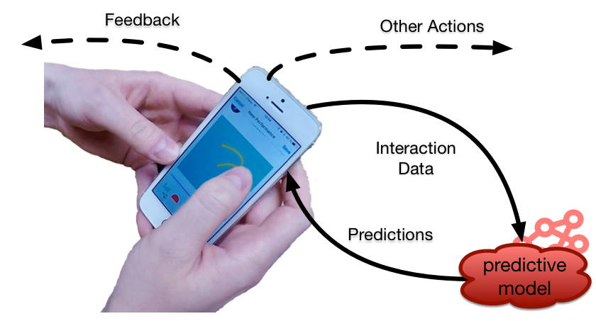
Project Description
Implementation of machine learning system to predict user interactions on a web application.
Uses:
Improve browser experience
Pre-send, pre-fetch data
recommendations
web caching
recover from errors

Slide 3
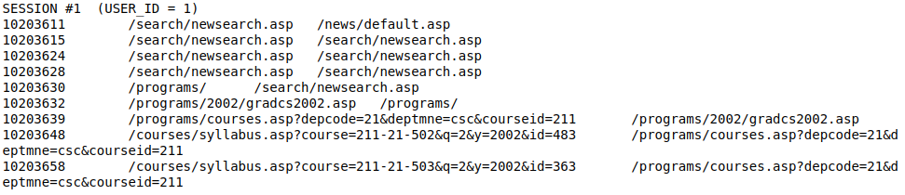
Sprint 1
Get Data
  Website Server logs
    20950 user sessions, 1 to 422 actions per session, 668 different url requests

Slide 4
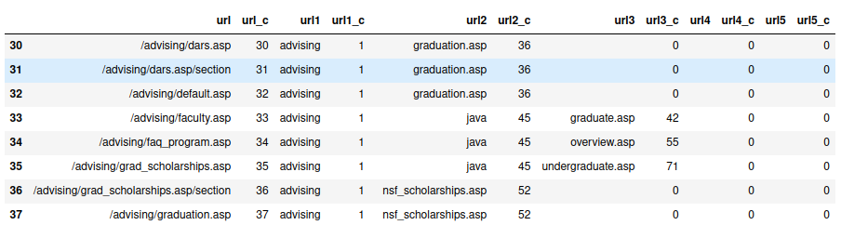
Sprint 1
Explore and Generate Dataset
  Generate features, sequences and classes.
    2326 sessions, sequences between 10 and 422 actions
    Features: User ID, url params, query params
    NO classes, cannot classify sequences (INCOMPLETE)
  Generate train, test/validation datasets.
    1628 training sequences, 698 testing/validation datasets

Slide 5
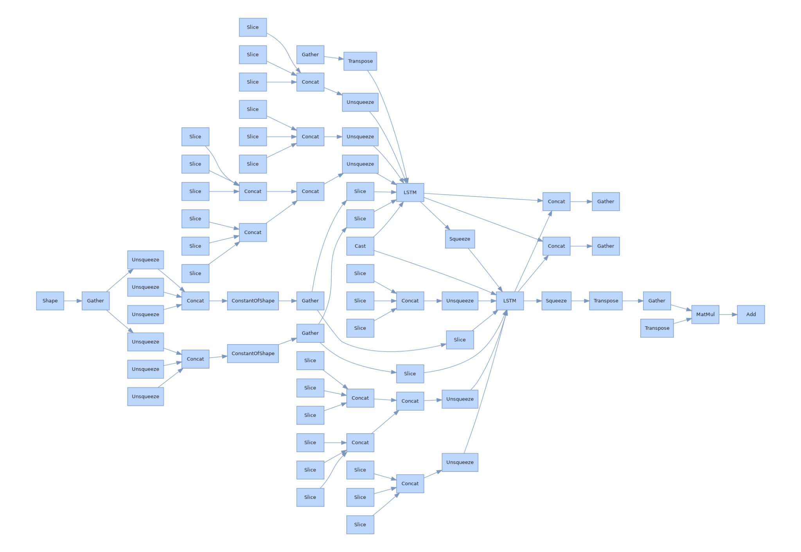
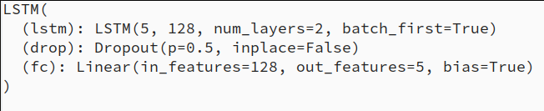
Sprint 1
Implement Basic DL model.
  LSTM model v1

Slide 6
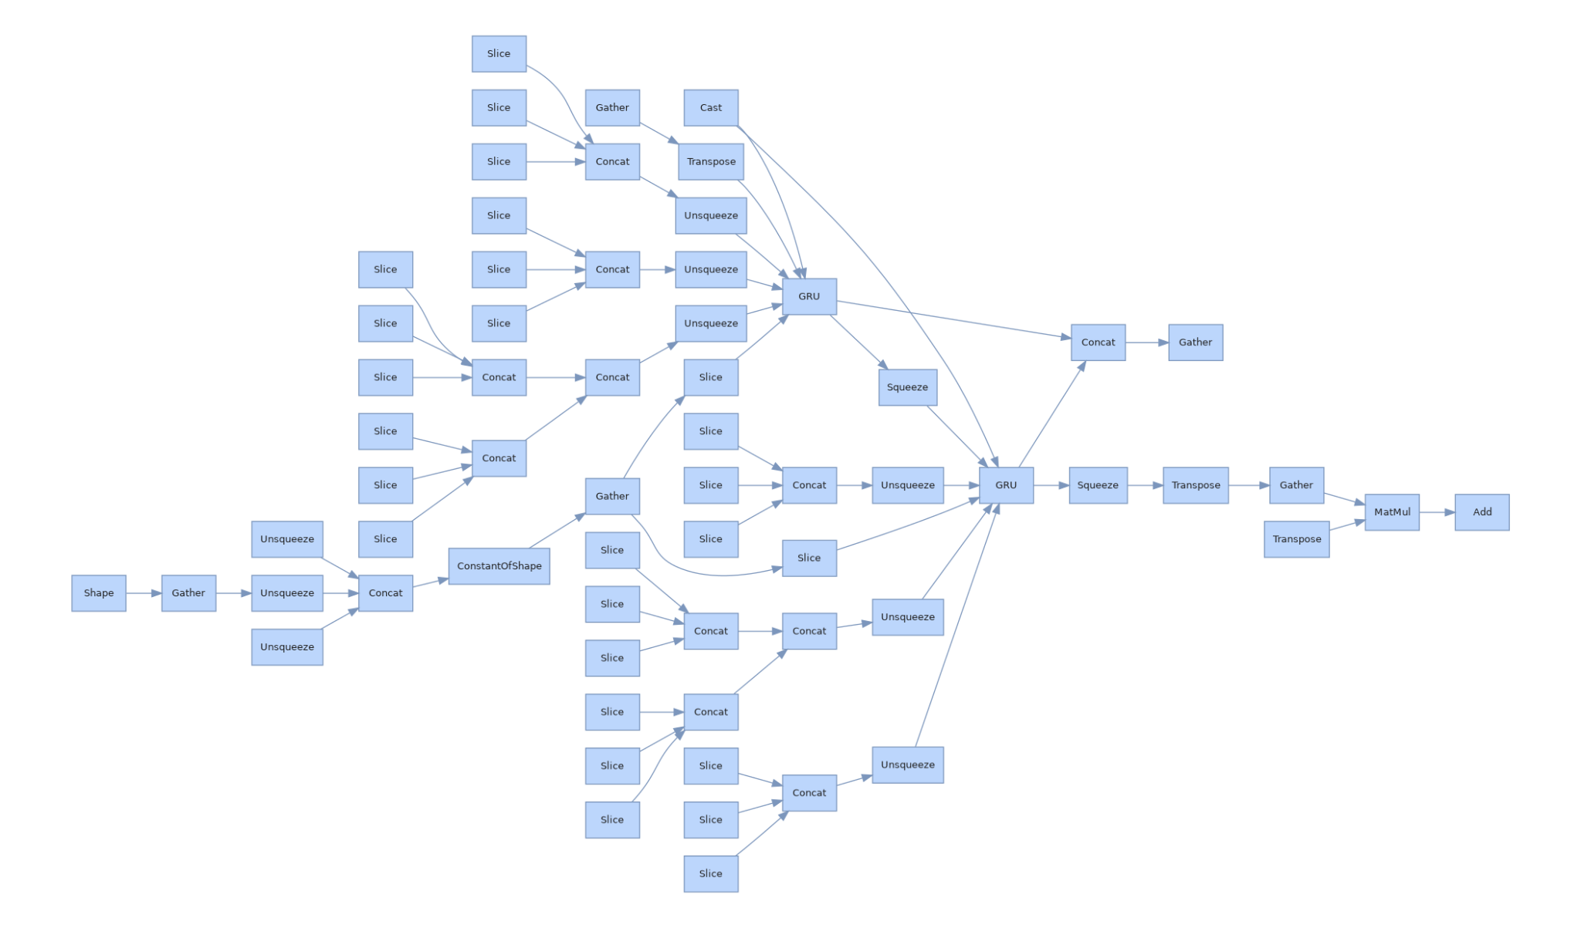
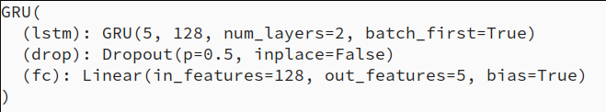
Sprint 1
Implement Basic DL model
  GRU model v1

Slide 7
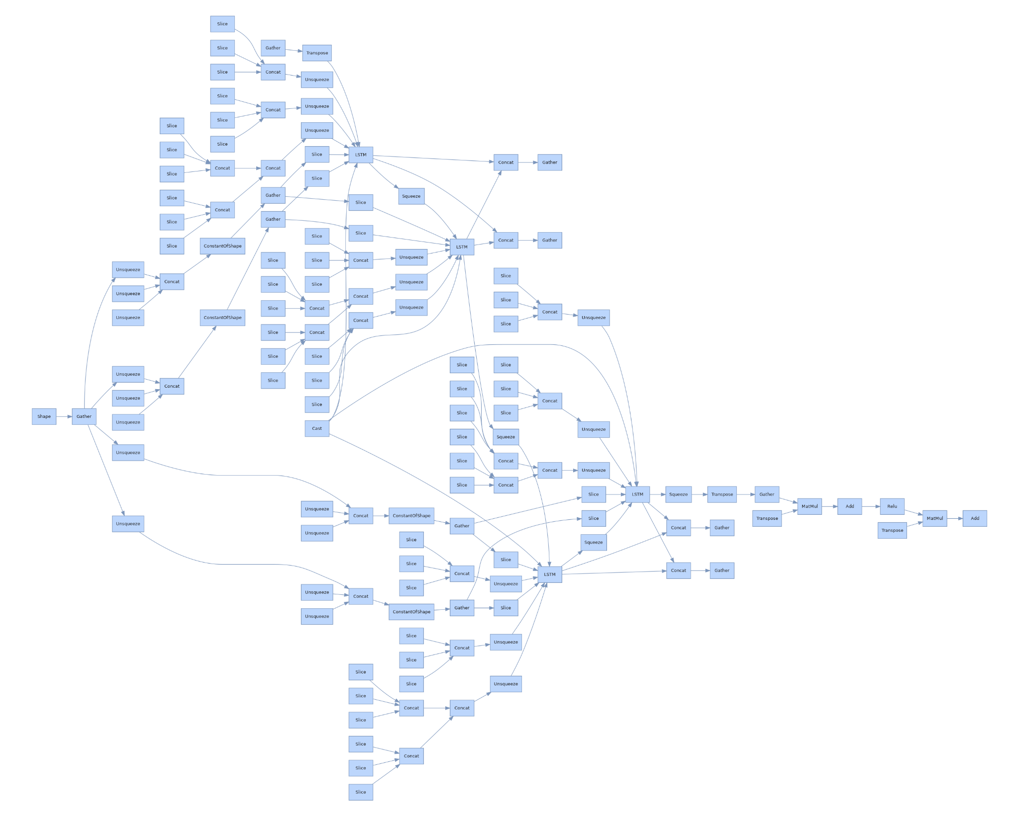
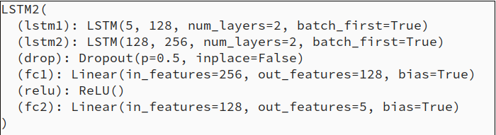
Sprint 1
Implement Basic DL model
  LSTM model v2

Slide 8
Sprint 2
Classify sequences. Update model for classification
Train/Validate model on sequence data
Improve models and select best model
Train/Test on bigger dataset (More features, i.e. knowledge forum)

